Slide 1
The Commons at Imperial Hotel
Mike Preston, M.S.W.
Regional Director for Supportive Housing
National Church Residences
November, 2016

Slide 2
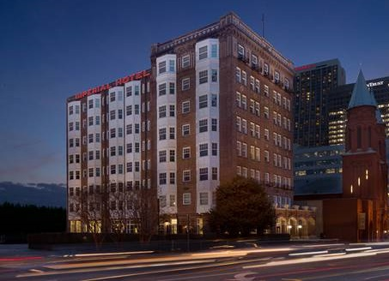
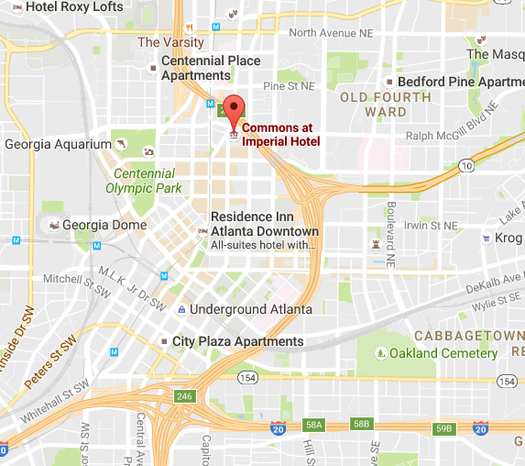
The Commons at Imperial Hotel

Slide 3
The Commons at Imperial Hotel Background
1910
Construction began on the Imperial Hotel: a $300,000 8-story Edward Dougherty-designed project with 119 rooms and 56 private baths.
1910’s – 1940’s
The Imperial was considered a leading mid-priced Atlanta hotel.
1940’s – 1970’s
Numerous nightclubs, both famous and infamous, operated from the Imperial.
Around 1980
Noted architect/developer John Portman purchased the property. Soon after, the hotel was closed and remained vacant for about 10 years.
1990
Homeless individuals and advocates occupied the abandoned building for weeks, demanding the City provide housing for the homeless; ending when the City agreed to build thousands of SRO units for the homeless.

Slide 4
The Commons at Imperial Hotel Background (cont.)
1994-95
Bruce Gunter of Progressive Redevelopment Inc. (PRI) received a $1 million loan from the City to redevelop the Imperial as affordable housing, targeting special needs residents.
2010
Unable to keep up with rising operating and maintenance costs, the building is placed in receivership.
2013
National Church Residences and Columbia Residential begin a comprehensive physical redevelopment with a sensitivity toward historic preservation, sustainable construction and operations (including LEED certification).
2014
On a snowy January day now known as “Snowmageddon,” Imperial re-opened, offering ninety (90) units of state-of-the-art Permanent Supportive Housing with updated amenities and onsite services, to serve formerly homeless and disabled Atlanta residents.

Slide 5
Safe, affordable housing is an important platform
for providing a system of care that improves the health, wellness, and self-sufficiency of vulnerable populations.
Successful Resident Outcomes
Quality Housing
Voluntary Participation
Progressive Engagement
Meet Clients
Where They Are
Quality
Housing
Attractive Units + Amenities
24/7 Front Desk Operations
Leasing and Rent Collection
Superb Facility Maintenance
Monthly Inspections
Progressive
Engagement
Housing Retention Plans
Appealing Social Services
Compelling Recreational Activities
Professional Case Management
Engaging Employment Services
Eviction
Prevention
Access
To Services

Slide 6
Imperial Program Model
The Commons at Imperial Hotel provides 90 units of single-site, integrated permanent supportive housing for very low-income individuals that have struggled with long-term homelessness and disabling conditions, using a housing first model. Collaborative partnerships with CaringWorks, PCCI, and Mercy Care provide onsite integrated primary, behavioral health, and employment services.

Slide 7
The Commons at Imperial Hotel embraces a
Person-Centered Approach
Community Engagement
Employment Services
Recovery Support
Supported Work Program
Civic Volunteerism
Stable Housing
24/7 front Desk
Security Cameras
Monthly Inspections
Housing Retention Plans
Resident
Healthcare
Wellness Exams
Medication Monitoring
Crisis Prevention
Psychiatric Consultation
Supportive Services
Case Management
Mental Health
Crisis Intervention
Assertive Engagement
Referrals and Linkage

Slide 8
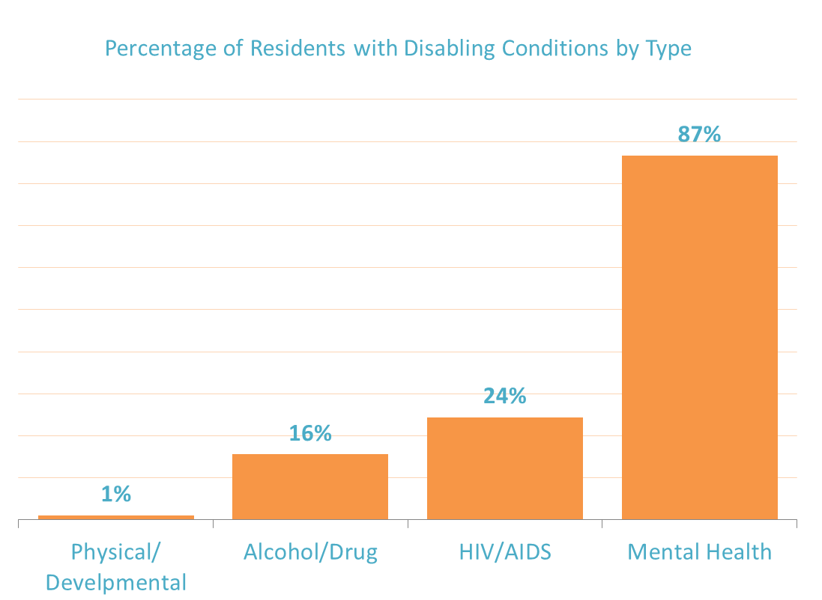
The Commons at Imperial Hotel serves the most vulnerable homeless individuals with severe, chronic disabling conditions.
69%
OF RESIDENTS HAVE TWO OR MORE DISABLING CONDITIONS
Data includes only Commons at Imperial Residents. Population Characteristics , August 2016

Slide 9
The Commons at Imperial Hotel serves the most disadvantaged individuals who have few or no resources.
$
$
33%
AVERAGE RESIDENT
MONTHLY INCOME IS
$540
OF RESIDENTS HAVE NO INCOME
Data is Commons at Imperial Hotel only. Population Characteristics, August 2016 and HUD Annual Performance Reports FY2015

Slide 10
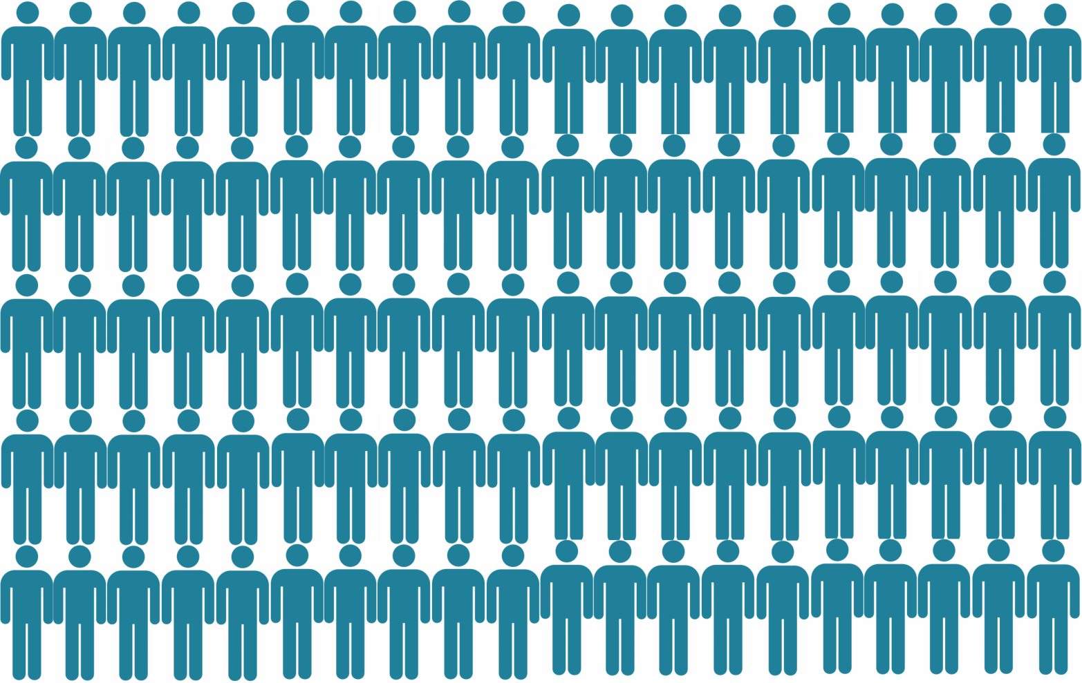
The Commons at Imperial Hotel Resident Engagement Rate with Supportive Services in 2016
100%
Source: CareGuide CM Notes Report 2016 YTD

Slide 11
Residents move from isolation to greater independence as their
physical, mental, emotional and financial well-being improve.
$
Safe, Affordable Housing
On Site Medical Care
Employment and Civic Connections
Wrap-Around Supportive Services
On-Site Mental Health Professionals
Greater Independence
Pathway to Success
Community Engagement and Education

Slide 12
Challenges:
Funding for Supportive Services
When the Imperial was being redeveloped, most stakeholders believed that funding for services would be available from multiple sources:
Medicaid
Tri-Jurisdictional Continuum of Care
Georgia Department of Behavioral Health and Developmental Disabilities
Fulton County Department of Human Services
City of Atlanta
What actually happened when the Imperial re-opened in 2014:
While states like Ohio expanded Medicaid, thereby significantly increasing access to healthcare for residents in supportive housing, Georgia opted not to expand
The Tri-J was dismantled and a new Continuum of Care was being formed
GDBHDD was overhauling it’s contracting processes, and awards were decreased
Suffering from diminishing revenues, Fulton County Human Services also cut back on contracts for vital services in PSH
While the City provides the rental assistance, support promised for supportive services was not available by the time the building re-opened

Slide 13
Recognition:
The Commons at Imperial Hotel is the proud recipient of many awards honoring the historic preservation of affordable housing for those special needs:
2014:
National Affordable Housing Tax Credit Coalition: Charles L. Edson Award for Excellence
National Housing and Rehabilitation: Timothy Anderson Award for Historic Preservation
National Association of Local Housing Finance Agencies: Exemplary Project: HOME funds
National Trust for Historic Preservation: Preservation’s Best Awards
Atlanta Regional Commission: Overall Developments of Excellence Award
City of Atlanta: Atlanta Urban Design Commission Award of Excellence in Historic Renovation
American Institute of Architects: AIA Atlanta Honor Awards for Residential Design
Georgia Association of General Contractors: Best Sustainable Building Practices Award
Atlanta Planning and Advisory Board: Excellence in Redevelopment and Community Engagement
2015:
National Affordable Housing Management Association: Best Rehab of Historic Structure
Georgia Trust for Historic Preservation: Marguerite Williams Award for Excellence

Slide 14
QUESTIONS?
Michael Preston MSW, LSW
Regional Director, Supportive Housing
National Church Residences
398 South Grant Ave
Columbus OH 43215
Direct: 614.716.0889
mpreston@nationalchurchresidences.org

