Slide 1
Overview of Tapestry Development Group
Jon Toppen
Georgia Supportive Housing Association
Fall Conference
November 7th, 2016

Slide 2
Overview
About Tapestry Development Group
Tapestry’s place in the provision of supportive housing
Example supportive housing projects

Slide 3
Tapestry Development Group, Inc.
A specialist in affordable rental housing development and consultation, with over three decades of combined experience
Mission driven 501(c)3 non-profit
Experienced in all types of affordable housing (senior, supportive housing, workforce housing, rural, urban, etc.)

Slide 4
Tapestry’s place in the provision of supportive housing

Slide 5
Defining supportive housing
Quality housing suitable to their individual needs
Affordable to their level of income (which may be zero)
Connects people to needed services, sometimes at home

Slide 6
Types of Supportive Housing
Housing Tenure
Shelter
Transitional
Permanent
Housing Type
Affordable Rental
Market/conventional rental
SROs
Quads / rooming house / group home

Slide 7
Types of Supportive Housing
Housing Tenure
Shelter
Transitional
Permanent
Housing Type
Affordable Rental
Market/conventional rental
SROs
Quads / rooming house / group home

Slide 8
The People of Supportive Housing
Household Composition
Youth/children
Families
Individuals
Seniors
Women / Men only
Veterans
Physical disabilities
Roles
Owner
Developer
Service Provider
Property Manager
Government / Investors / Other Funders
Other Professional Services (legal, architectural, etc.)

Slide 9
The People of Supportive Housing
Household Composition
Youth/children
Families
Individuals
Seniors
Women / Men only
Veterans
Physical disabilities
Roles
Owner
Developer
Service Provider
Property Manager
Government / Investors / Other Funders
Other Professional Services (legal, architectural, etc.)

Slide 10
Three-Legged Stool
Tenant Services
Housing
Property Operations

Slide 11
The Development Process

Slide 12
Example Supportive Housing Projects

Slide 13
O’Hern House
Owner: Project Interconnections, Inc.
Location: Atlanta, MLK historic district
Housing First model
76 units SRO units (all have Atlanta Housing Authority PBRA)
Services and Meals provided by Community Friendship, Inc.
$3 mil rehab completed in 2011 (DCA PSHP funds)

Slide 14
Summit Trail
Owner and Service Provider: CHRIS 180 (Formerly CHRIS Kids)
Location: East Atlanta, City of Atlanta, DeKalb County
Young Adults aged 17-24 (homeless and/or aging out of foster care)
46 units with SROs, 1 and 2 bedrooms
Atlanta Housing Authority Project Based Rental Assistance
$12 mil project completed in 2010 (DCA PSHP funds, private capital campaign, City of Atlanta (Homeless Opportunity Funds)

Slide 15
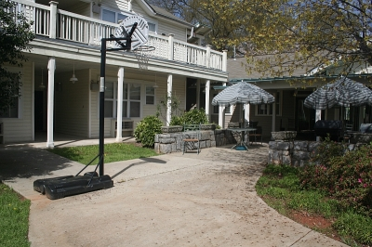
Presley Woods Apartments
Owner: Project Interconnections, Inc.
Location: Kirkwood Neighborhood, City of Atlanta, DeKalb County
20 units (50%) homeless with mental illness (Shelter Plus Care)
20 units (50%) low income residents (DeKalb County Section 8)
Built 1995, rehabilitated 2013
Service Provider: Community Friendship, Inc.

Slide 16
Greystone Apartments
Owners: Tapestry Development Group and In-Fill Housing (Macon)
Location: City of Rome, Floyd County, Georgia
71 one bedrooms serving seniors and people with disabilities
17 Section 8 from Housing Authority (seniors only); 15 Shelter Plus Care
Highland Rivers Health of Dalton, Ga. – service providers
Built 1905, rehabbed to housing 1992, rehab 2015 using LIHTC / HTC
$10 million development budget

Slide 17
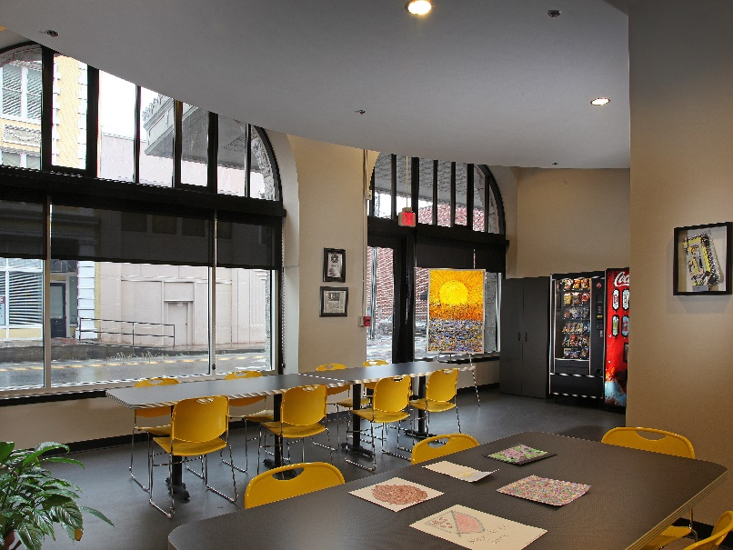
Greystone Apartments

Slide 18
Phoenix House
Owners: Tapestry Development Group, Project Interconnections, National Housing Trust (Washington DC)
Location: City of Atlanta, Fulton County, Georgia (nearly Oakland City MARTA)
69 efficiencies serving formerly homeless individuals with mental illness
44 Section 8 from Atlanta Housing Authority; 25 Shelter Plus Care
Community Friendship – service provider
LIHTC plus philanthropic funding, Invest Atlanta loan
$10+ million development budget

Slide 19
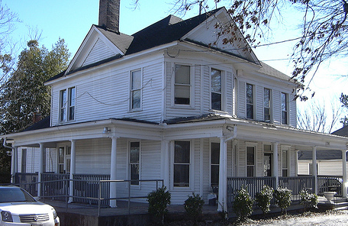
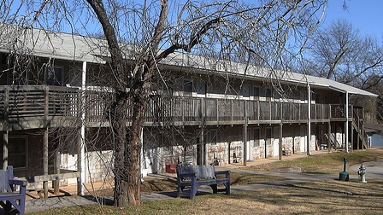
Phoenix House

Slide 20
For more information contact:
Jon Toppen
(404) 997-6788
jontoppen@tapestrydevelopment.org
www.tapestrydevelopment.org

