Slide 1
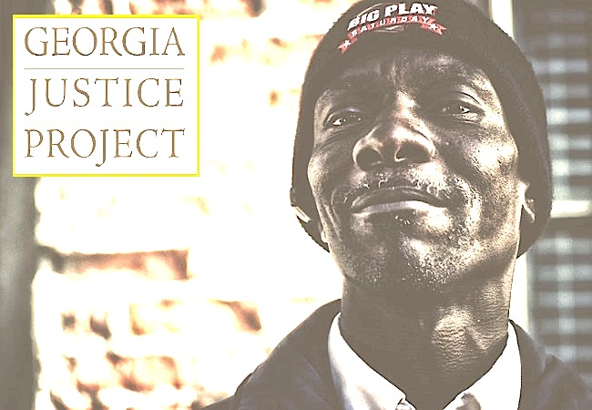
GJP’S
Complementary
Approach
Transformative Action through Pragmatic Solutions
Doug Ammar
Executive Director,
Georgia Justice Project

Slide 2
Georgia Supportive Housing Association
June 15, 2016
Douglas B. Ammar
Executive Director,
Georgia Justice Project

Slide 3
Agenda
WHAT GEORGIA JUSTICE PROJECT DOES.
HOLISTIC DEFENSE
CRIMINAL RECORDS REPRESENTATION
POLICY & EDUCATION
(See Handouts)
ADVOCACY
Notes:
Remind about survey

Slide 4
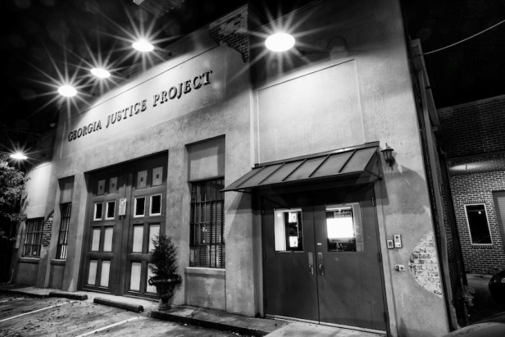
Georgia Justice Project
Direct Service
Holistic Criminal Defense
(Fulton & DeKalb)
Criminal Records (Georgia)
Advocacy & Education
(Georgia)
Notes:
CH direct service – restriction/expungements, corrections, counseling, corrections, advocacy to decision-makers

Slide 5
Direct service –Holistic Defense
Private Public Defender on Steroids
Social service Support
During the Case
After the Case is Over
Prison Visitation
Family Visits (Prison)
Post Release Support
Community Gatherings
Back to School Event
Client Christmas Party

Slide 6
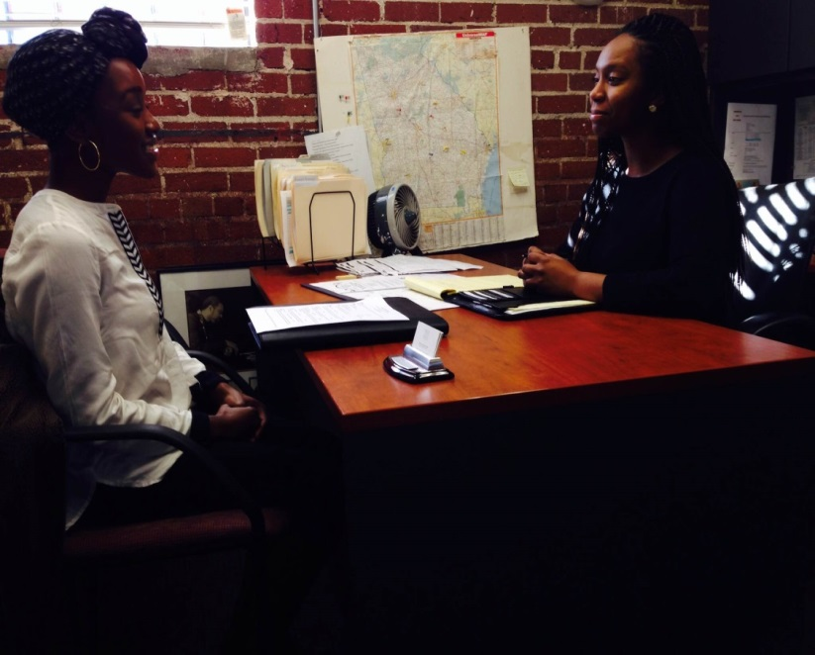
Direct service – Criminal Records
Record Restriction
Corrections
First Offender
Housing
Denied housing based on your record
Private Background Issues
Pardons

Slide 7
Record Restriction
Definition: process through which information about a charge is made private for all purposes except law enforcement.
Eligibility: depends on how the case was resolved.
Cycle by cycle
You do not need an attorney to apply

Slide 8
Restricted vs. Sealed
Sealed – Judge’s Order
Restricted (Expunged)
Doesn’t show up on GCIC report for most purposes
File still available at clerk’s office
File at clerk’s office is sealed, indexes removed, no longer public record
Only accessible to law enforcement or by court order
Notes:
Restricted – still avail to private companies, who can report non-convictions for 7 years
Sealed – no longer public record

Slide 9
What GJP can do?
Possible:
Record Restriction
Corrections
First Offender
Housing (you were denied housing based on your record)
Private Background Issues
Pardons
Sealing Records that have been Restricted
Cannot:
You want a conviction off your record (Except Youthful Offender)
Your charges are minor (Traffic charges or FTA)
Have an active case
You want to appeal a conviction
You can afford your own attorney

Slide 10
What Charges are Eligible?
Non-Convictions
Convictions
Generally eligible
Not Forwarded for Prosecution
NPGJ
No Billed (New)
Dismissed/Nolle Prossed
Acquitted (New)
Dead Docketed
Reversed/Vacated Conviction (New)
Conditional Discharge (New)
Drug/Mental Health/Veteran Court (New)
Generally not eligible
Pled Guilty
Pled Nolo Contendere
Convicted at trial
Notes:
Acquitted (use definition of not guilty)
No Billed (no formal charge entered because the grand jury did not return a bill of indictment)
Dead Docketed – apply in Fulton/DeKalb through paper application. Outside jurisdictions will more than likely require court action
Reversed/Vacated Conviction requires filing a petition to the court
Conditional Discharge (used for drug offenses. Eligible once successful completion of sentencing terms)
Drug/Mental Health/Veteran Court – case dismissed once successful completion of program. Once the dismissal is filed, arrest is eligible for restriction.
Exceptions of non-convictions that are not eligible:
Pled guilty to another charge in the case
Material evidence suppressed
Pattern of criminal activity prosecuted elsewhere
Immunity
Convictions not eligible (talk about Youthful Offender)

Slide 11
Application Process
Intake 9:30am to 4:30pm, Mon-Thurs
Can mail application
Recent GCIC report or $10 fee (waived with documentation of homelessness)
Take a limited number of clients
If selected as a client, next step is appointment with staff or volunteer attorney
Complete employment assessment/meet with social services
No charge for legal assistance - but Court fees

Slide 12
Georgia Justice Project’s Evolution to Policy Work
Grounded in Direct Service:
Legal & Social Service Support
Started with a focus on employment
Established subject matter expertise
Built unlikely relationships

Slide 13
Reducing Barriers To Reentry – Policy Wins
2016
Removal of Food Stamp Ban Ga. Code Ann. § 49-4-22
Sealing of First Offender Records Ga. Code Ann. § 42-8-62.1
Occupational Licensing Reform Ga. Code Ann. § 43-1-19
Retroactive Reinstatement of Driver’s Licenses Revoked for a Drug Offense Ga. Code. Ann. § 40-5-75(g) and § 40-5-9
Tax Incentive for Parolee Hiring – Ga. Code Ann. § 48-7-40.31

Slide 14
Reducing Barriers To Reentry – Policy Wins
2015
Ban the Box – Executive Order signed February 23, 2015
First Offender Eligibility – Ga. Code Ann. § 42-8-61
Retroactive Remedy for First Offender Eligibility – Ga. Code Ann. § 42-8-66
Georgia Fair Business Practices Act – Ga. Code Ann. § 10-1-393.14

Slide 15
Reducing Barriers To Reentry – Policy Wins
2014
Driver’s License Suspension – Ga. Code Ann. § 40-5-76(b)
Mugshots Online – Ga. Code Ann. § 35-1-18
Prohibits law enforcement from publishing mugshots
Employer Liability – Ga. Code Ann. § 51-1-54
Provides some protection from negligent hiring liability

Slide 16
Reducing Barriers To Reentry – Policy Wins
2013 & 2013
Mugshot Removal – Ga. Code Ann. §10-1-393.5
Requires mugshot companies to remove photos when the charge(s) is eligible for restriction. Photos must be removed within 30 days of a request, free of charge.
Record Restriction Law – Ga. Code Ann. § 35-3-37
Expanded access to restriction (expungement from official criminal history) for non-convictions & certain misdemeanor convictions
Improved process, reducing the costs, and allows restricted charges to be sealed so they cannot be reported by private background check companies.

Slide 17
Contact Information
Criminal Records Program
Georgia Justice Project
438 Edgewood Avenue
Atlanta, GA 30312
Intake:
(404) 827-0027 ext. 238
Website: http://www.gjp.org/programs/criminal-records/

